Slide 1

MT-Project
Startup Coffee Business

Slide 2
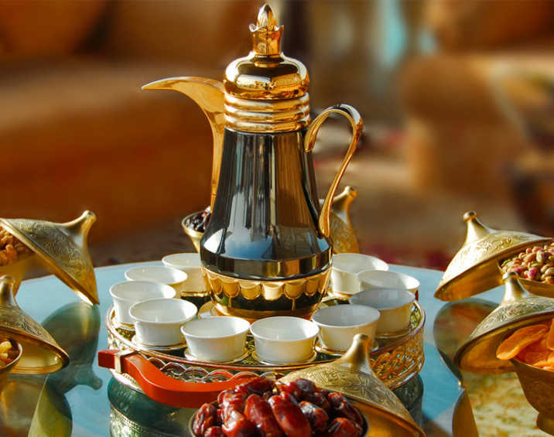
KSA Culture
Saudi Arabia well know with their generous host specially with Arabic Coffee which it has special taste.
Saudi Arabia has large and rich of coffee culture.

Slide 3

Determine best location
Investor like to determine best location in city to start new Coffee shop.
With help of Foursqure location data we can check the closet position to Jeddah city center; where there is not much coffee shops around.

Slide 4
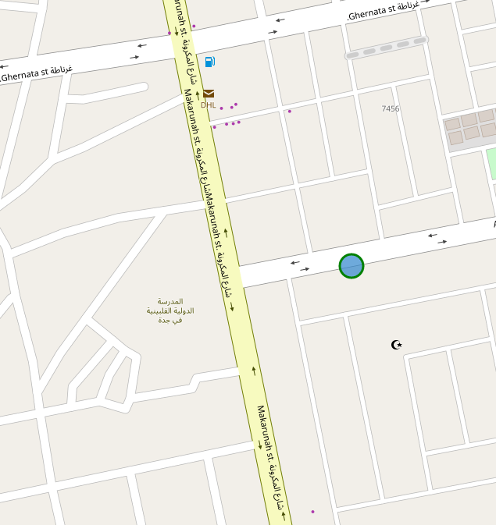
Module Output
The module final output will show the best location with blue circle in the map of Jeddah city.

